Slide 1




Big Data in Healthcare: Promises, Challenges and Opportunities MOHAMMAD ADIBUZZAMAN
Research Scientist, Purdue University
madibuzz@purdue.edu
@adibzaman
Notes:
Causally-driven Healthcare Science
From Observational and Experimental Studies to Personalized and Improved Patient Outcomes

Slide 2
Outline
Machine Learning for healthcare
Hemorrhage Detection
Evaluation of Machine Learning Algorithms
Compute Framework
Causal Inference

Slide 3
Hemorrhage Detection

Slide 4
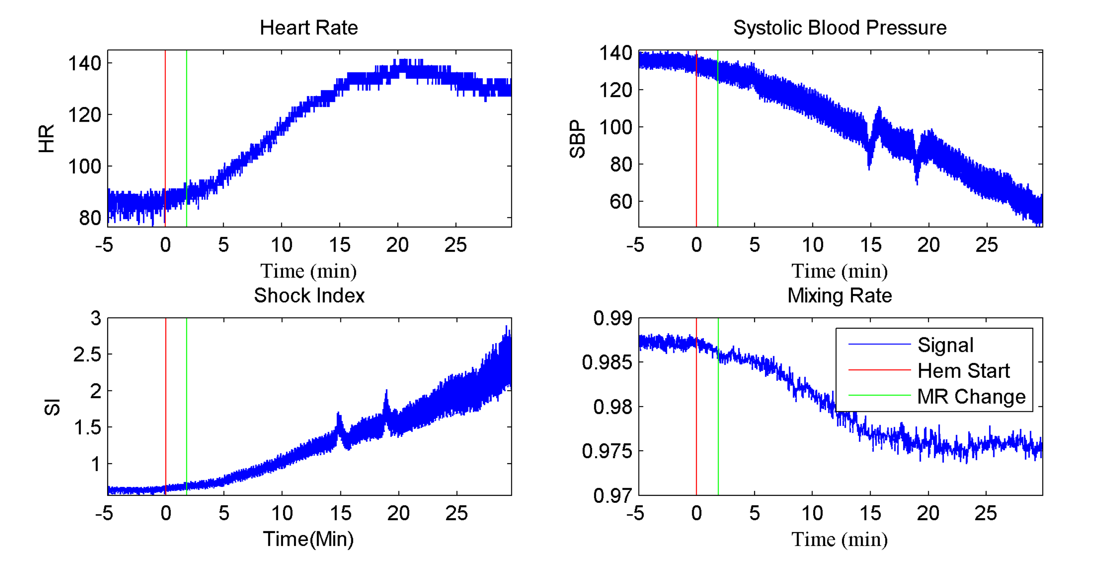
Hemorrhage Detection

Slide 5
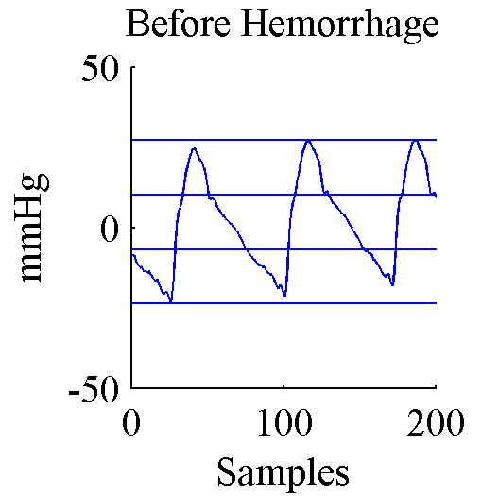
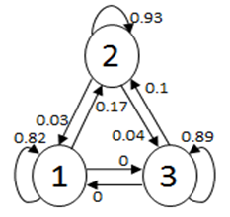
Methods
3
2
1
Arterial Blood Pressure
States
Markov Chain

Slide 6
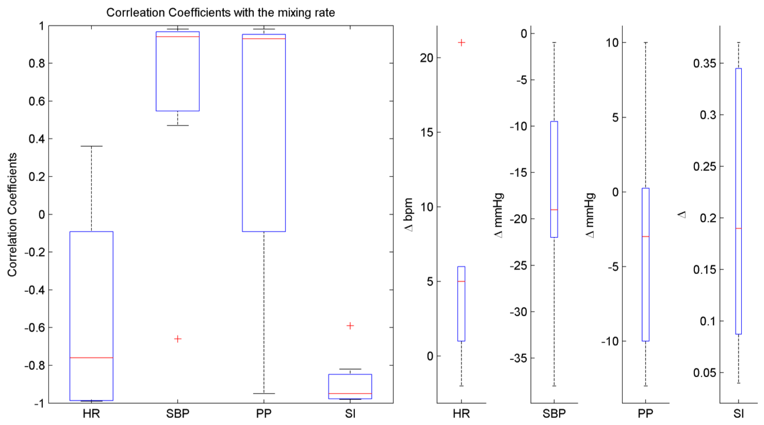
Results
HR = Heart Rate
SBP = Systolic Blood Pressure
PP = Pulse Pressure
SI = Shock Index

Slide 7
Evaluation of Machine Learning Algorithms

Slide 8
Medical emergency team activation (MET) criteria
Medical emergency team (MET) activation criteria is used in hospital settings as ‘clinically critical events’.
MET activation criteria was set as the event to predict.
MET activation criteria
Heart rate (<40 or >160 bpm)
Systolic blood pressure(<60 or >200 mmHg) or
Oxygen saturation (<85%)
The goal is to predict if MET activation will occur 60 minutes in advance (in the target window).

Slide 9
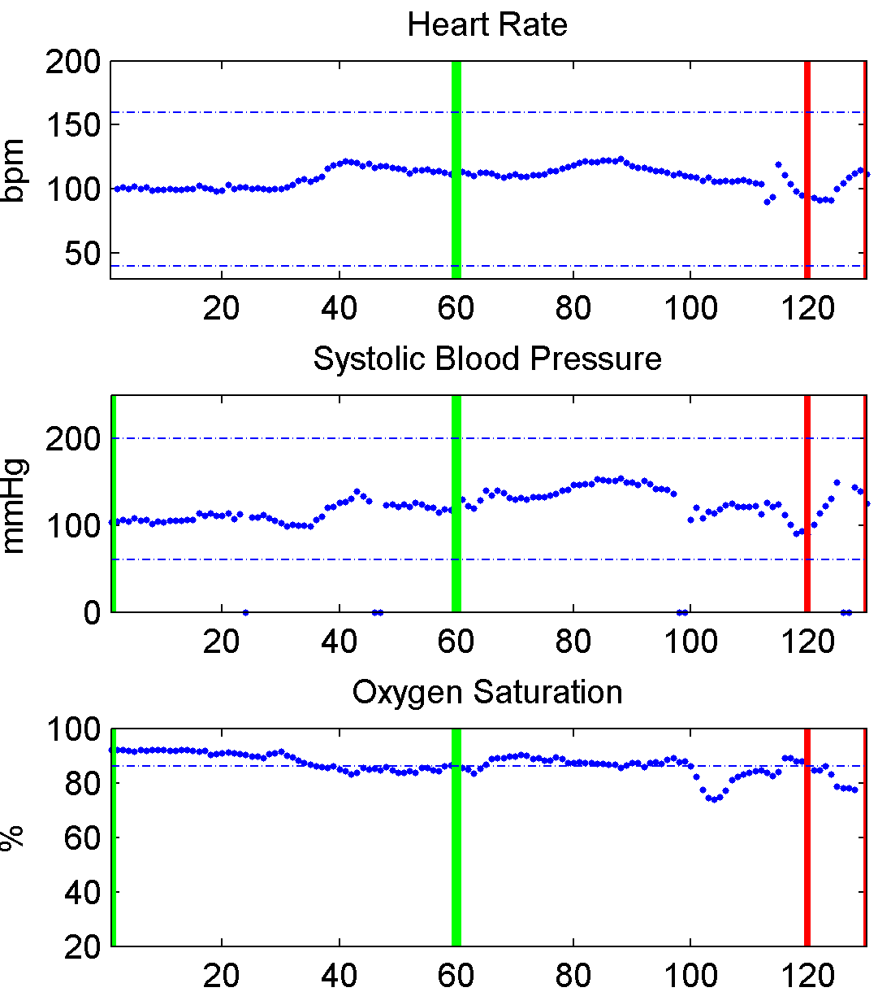
True Positive Event: Medical Emergency Team Activation (MET) Criteria Satisfied
Oxygen Saturation drops below 85%
(MET activation criteria)
Observation window
Gap window
Target window

Slide 10
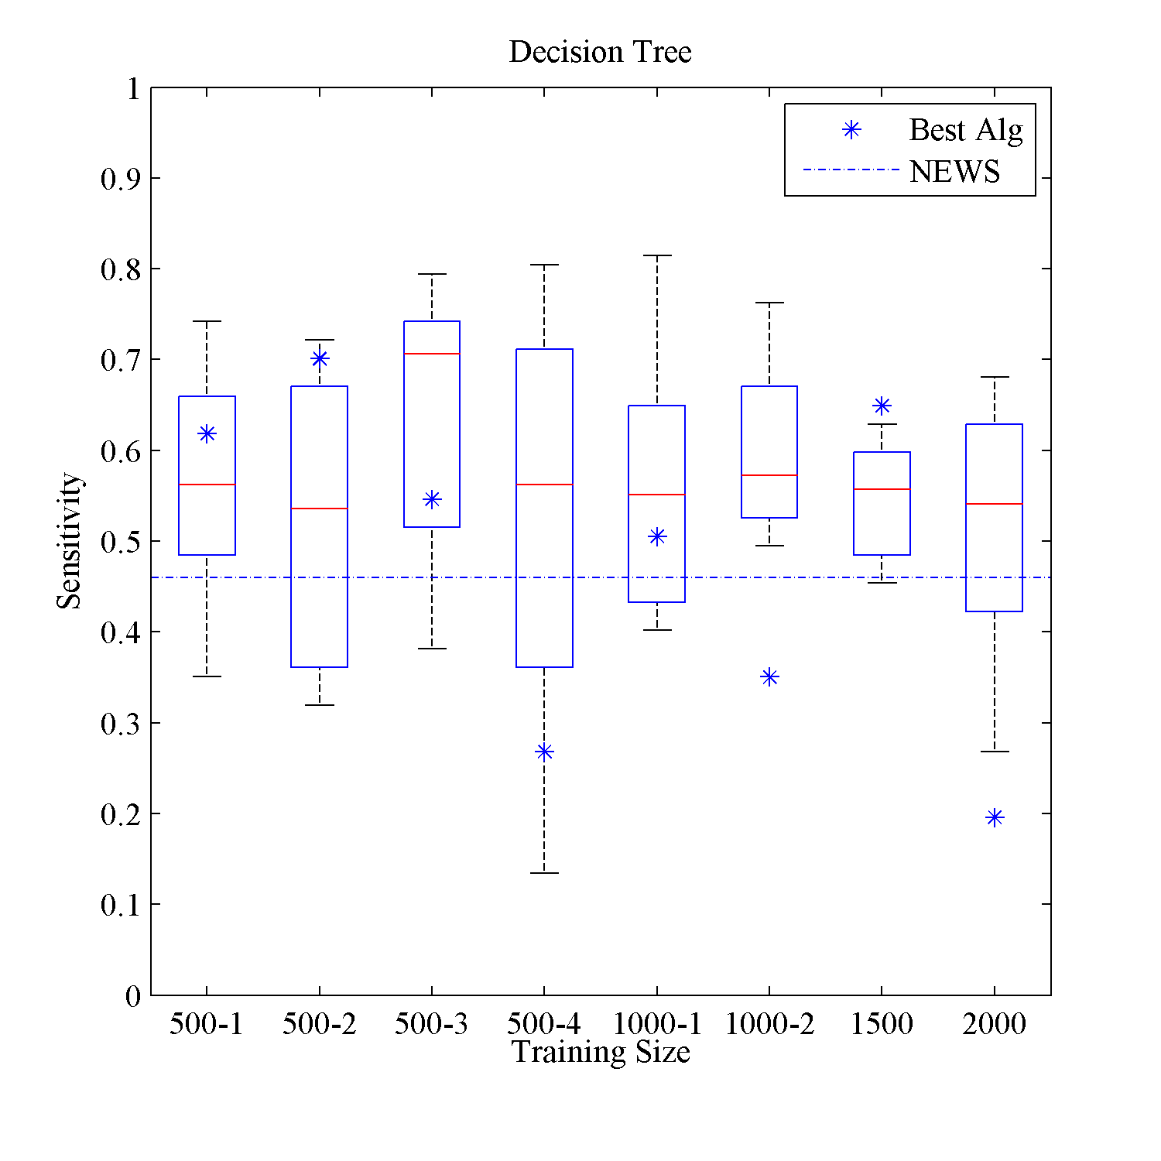
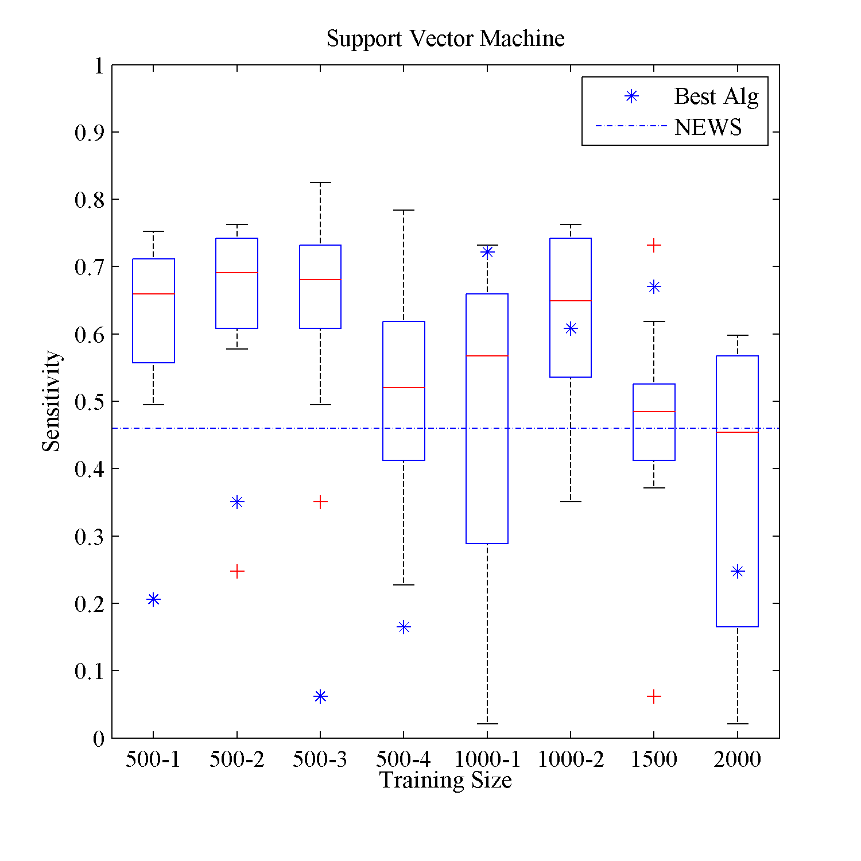
Results: Sensitivity to Detect MET Activation an Hour Before It Occurs
National Early Warning Score (NEWS)
Each box plot represent the results for the 10-fold cross validation for the independent validation set.

Slide 11
next generation computing and methodological framework
Different dimensions (EHR, genomics, imaging) and study design (selection bias, confounding bias, etc.) of data
Observational data (non-experimental big data): highly biased (confounding), big data
Randomized controlled trial (experimental data): Lack of external validity or generalizability
How do you combine a data (compute framework and statistical framework) to estimate causal effect for interventions?
Notes:
Q: Does the proposal address a challenging, leading edge question in data science fundamentals and/or application in the areas of interest to the solicitation?
Does the proposal address a challenging, leading edge question in data science fundamentals and/or application in the areas of interest to the solicitation?

Slide 12
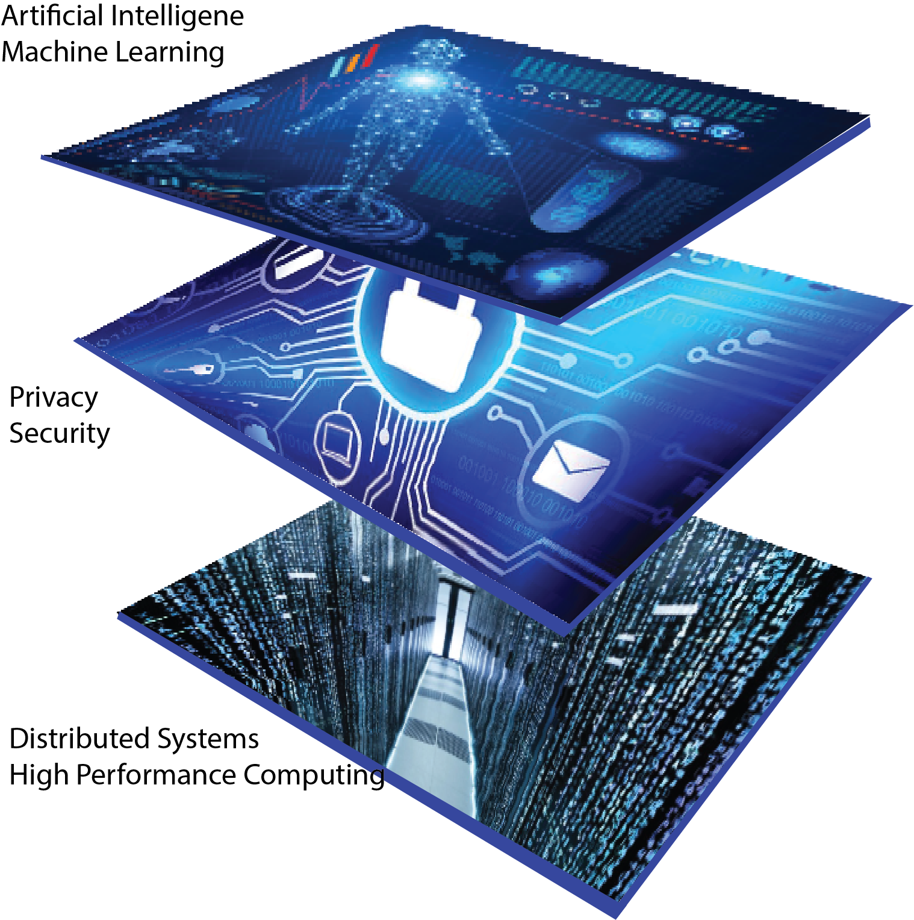
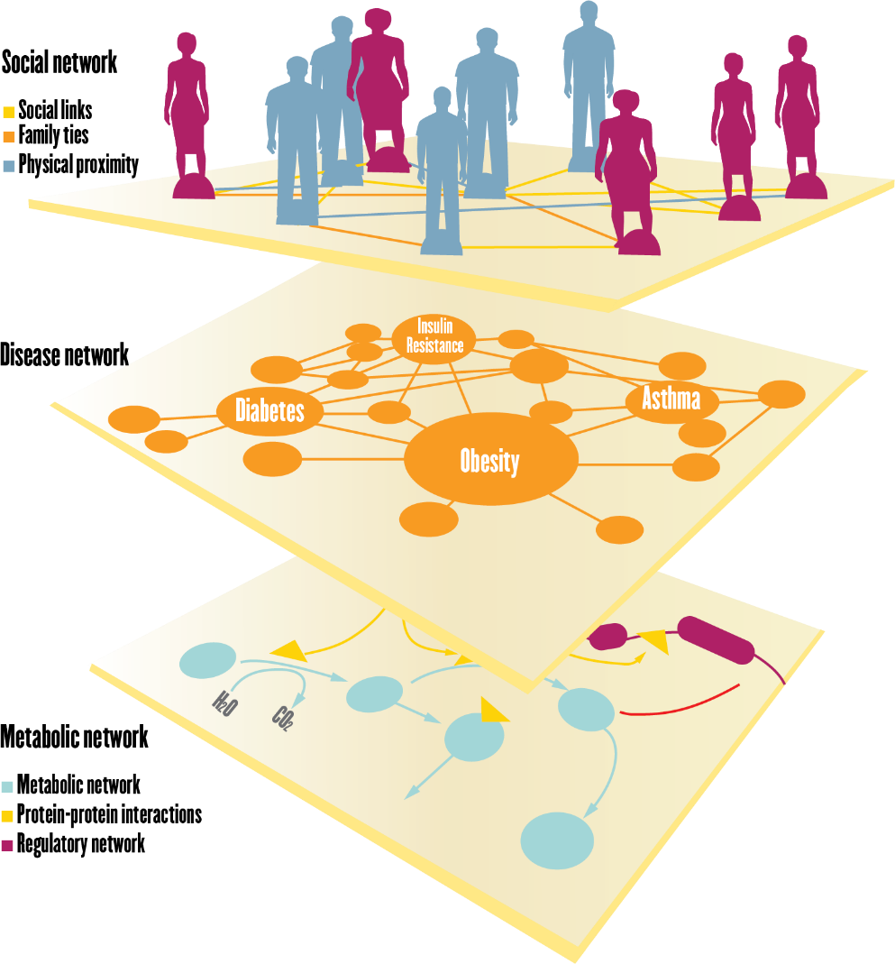
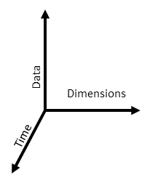
Big Picture
Dimensions of Life Sciences
Dimensions of Data Sciences

Slide 13
Computing Framework

Slide 14
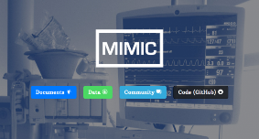


Computing framework: Current system
Open source technology
Scalable system
300TB data storage and computation
Currently supports SQL, images, time series
Demo
MULTIPLE DATA SOURCES
MIMIC III (Beth Israel Hospital EHR)
Cerner Health Facts (60M patients over 18 years)
Claims data
Indiana Medicaid (2012 to present)
Purdue Community (staff and families)

Slide 15
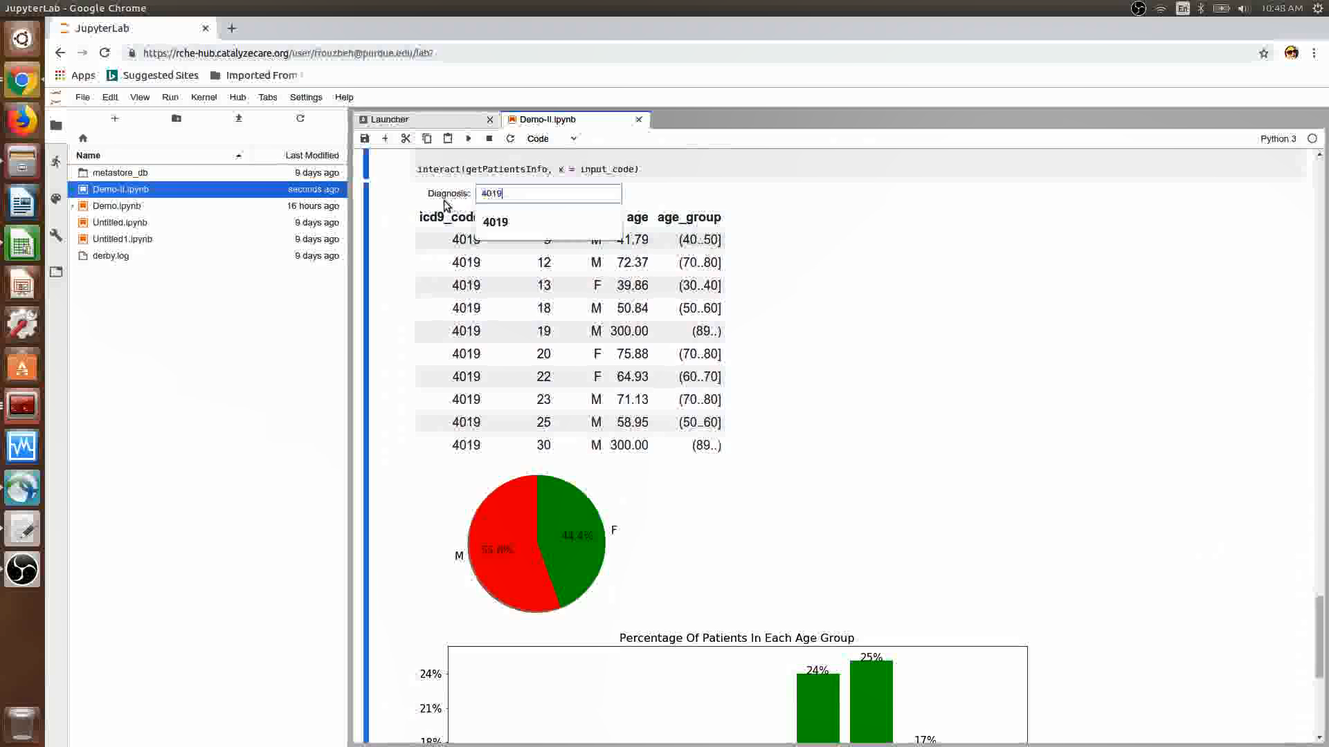
Current system

Slide 16
Causal Inference
Heart Failure, Acute Respiratory Distress Syndrome, Oxygen Therapy and Delirium Treatment

Slide 17
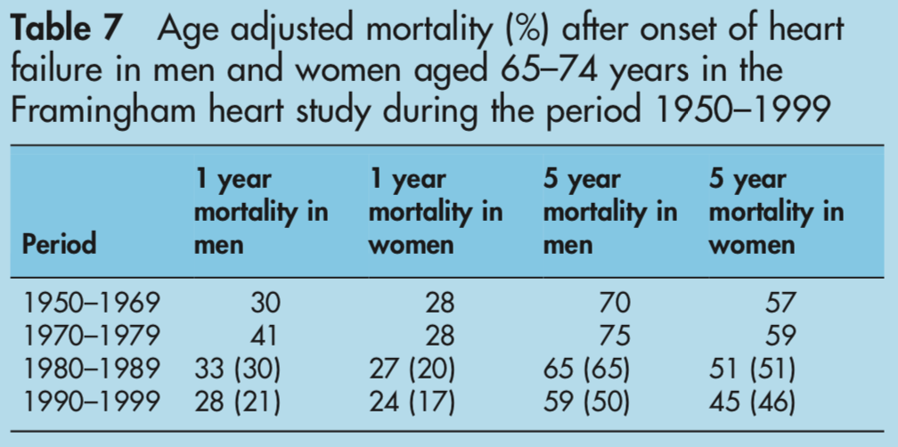
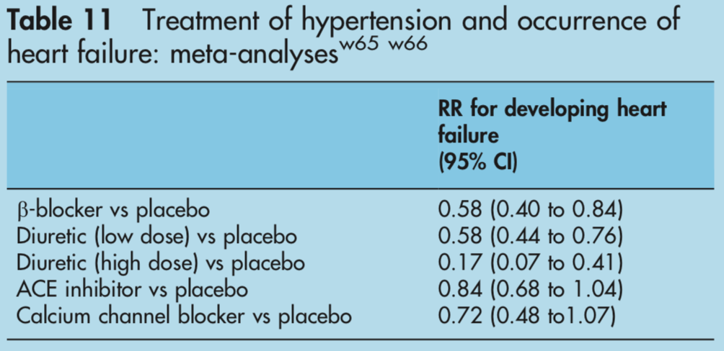
Heart failure (HF)
~6 million adults > 18 years old have HF¹
Expected to exceed 9 million by 2030²
50% of HF patients die within 5 years³
HF financial: ~$31 billion dollars annually^{1,2}
Furthermore, 50% of HF patients suffer from diastolic HF³ - HF with preserved ejection fraction
20% misdiagnosis rate of HF! *⁴
*Current research of this number is limited and may be underestimated
(Mosterd & Hoes, 2007)

Slide 18
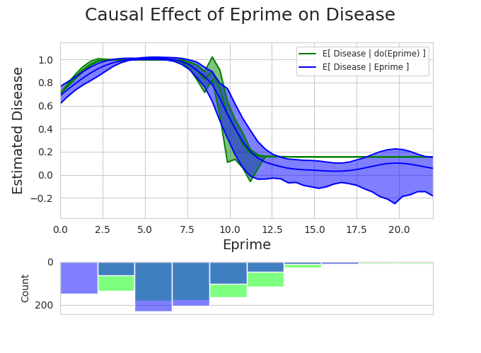
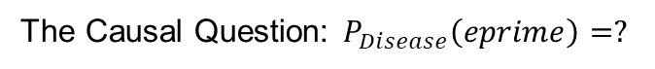
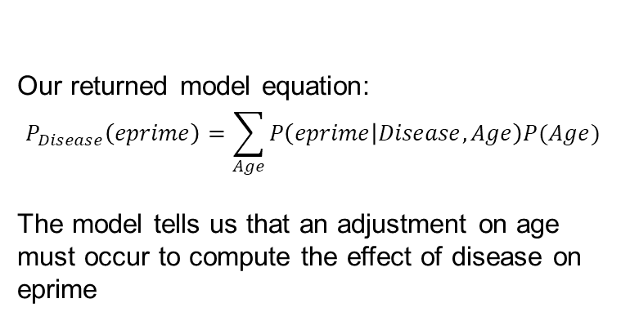
Causal effect of e-prime ON Disease
The Causal Question: $P_{Disease}\left(eprime\right)=?$
The model (green) based on the do-calc. versus the observations (blue)
Our returned model equation:
$$P_{Disease}\left(eprime\right)=\sum_{Age}{P\left(eprime | Disease,Age\right)P(Age)}$$
The model tells us that an adjustment on age must occur to compute the effect of disease on eprime

Slide 19
Example research projects
Google Health - https://ai.google/healthcare/
Nature Medicine – Sepsis –(Infectious disease with EHR) https://www.nature.com/articles/s41591-018-0213-5
PNAS – Data Infrastructure -OHDSI https://www.pnas.org/content/113/27/7329

Slide 20
Clinical Data Networks
PIC-SURE – Harvard precision medicine
https://pic-sure.org/training/graduate-level-courses/precision-medicine-ii
All of us- NIH precision medicine
Vanderbilt, Broad and Verily (Google)
https://www.joinallofus.org/en
OHDSI- Columbia, Stanford, IU Health consortium
https://ohdsi.org/
iDASH- UC San Diego
https://www.ncbi.nlm.nih.gov/pmc/articles/PMC3277627/

Slide 21
Funding opportunities
All of us- 10 year (at least) for One million patients
Already awarded ~200M and much more to come
https://allofus.nih.gov/
Million Veterans Program (MVP)- One million patients
https://www.research.va.gov/mvp/
NIH NHLBI – TOPMED- ~100K patients with genomics information
https://www.nhlbi.nih.gov/science/trans-omics-precision-medicine-topmed-program
NSF
Industry
ROCHE
Google
Lilly
Microsoft
Amazon
DARPA
Foundations
Howard Hughes
Broad
Sloan Kettering

Slide 22
Acknowledgement
Ananth Grama, Professor, Computer Science, Purdue University
Paul Griffin, Director, Regenstrief Center for Healthcare Engineering, Purdue University
Elias Bareinboim, Associate Professor, Columbia University
Roger Mark, Professor, MIT
Pavlos Vlachos, Professor, Mechanical Engineering, Purdue University
Fatemeh Rouzbeh, Graduate Student, Computer Science, Purdue University
Brett Collar, Graduate Student, Mechanical Engineering, Purdue University

